Slide 1
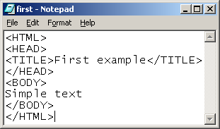
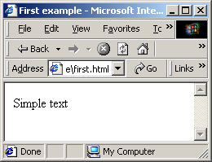
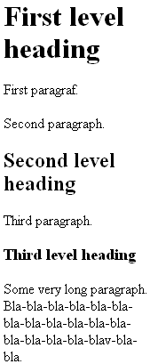
HTML pamati
Notepad vai Wordpad
bet ne Word (ASCII bet ne .doc)
File / Save As / first.html
Pārlūkprogramma (Open browser)
File / Open / Browse / first / OK
<BODY>
Simple text
Forth raw
</BODY>
Simple text Forth raw
Virsraksti un rindkopas
<BODY><H1>First level heading</H1> <P>First paragraf.</P> <P>Second paragraph.</P>
<H2>Second level heading</H2> <P>Third paragraph.</P>
<H3>Third level heading</H3>
<P>Some very long paragraph. Bla-bla-bla-bla-bla-bla-bla-bla-bla-bla-bla-bla-bla-bla-bla-bla-blav-bla-bla. </P></BODY>

Slide 2




H1-H6 nav ievietoti cits citā
Teksta formatēšana
Some <B>l</B>ine of <I>text</I>.<BR>Next <B><I>l</B>ine.
Hipersaite
<A HREF="C:\First.html"> Link to first</A>
Attēlas ievietošana
<IMG SRC="C:\tabhelp.gif">
<IMG SRC="C:\tabhelp.gif“ ALT="Help">
<IMG SRC="C:\tabhelp.gif" WIDTH=“80" HEIGHT=“20">
Attēla kā hipersaite
<A HREF="C:\First.html"> <IMG SRC="C:\tabhelp.gif"> </A>
<A HREF="C:\First.html"> <IMG SRC="C:\tabhelp.gif“ BORDER=“0”> </A>

Slide 3



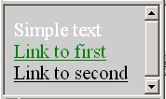
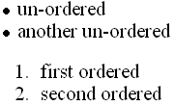
Krasa, Fonts un Līdzināšana
<FONT COLOR="red">Text in red.</FONT> <FONT FACE="Arial, Verdana, Helvetica">In any mentioned above fonts.</FONT>
<P ALIGN="center">This is center</P>
Lapu īpašības
<BODY BGCOLOR="#CDCDCD" TEXT="white" LINK="green" ALINK="black" VLINK="red">
Simple text
<A HREF="C:\First.html"> Link to first</A>
<A HREF="C:\Second.html"> Link to second</A> </BODY>
Saraksti
<UL> <LI>un-ordered <LI>another un-ordered </UL>
<OL> <LI>first ordered <LI>second ordered </OL>
<UL TYPE=“{ disc (default) | square | circle }” …>
<OL TYPE=" { 1 (default) | a | A | i | I }"...>

Slide 4
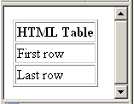
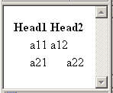
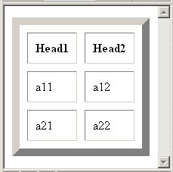
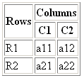
Tabulas
<TABLE BORDER="1"> <TR> <TH>HTML Table</TH> </TR> <TR> <TD>First row</TD> </TR> <TR> <TD>Last row</TD> </TR> </TABLE>
<TABLE> <TR><TH>Head1</TH> <TH>Head2</TH></TR> <TR><TD ALIGN="RIGHT"> a11</TD><TD>a12</TD></TR> <TR ALIGN="RIGHT"> <TD>a21</TD><TD>a22</TD></TR> </TABLE>
<TABLE BORDER="10" CELLSPACING="10" CELLPADDING="10">
…
</TABLE>
< TABLE BORDER="1"> <TR ALIGN=“CENTER"> <TH ROWSPAN="2">Rows <TH COLSPAN="2">Columns <TR><TH>C1<TH>C2 <TR><TD>R1<TD>a11<TD>a12 <TR><TD>R2<TD>a21 <TD>a22 </TABLE>

Slide 5



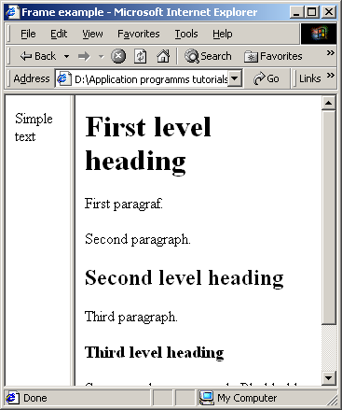
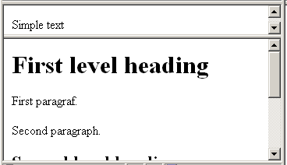
<TR><TD>R2<TD>a21 <TD >a22 a22 a22
<TR><TD>R2<TD>a21 <TD WIDTH="10">a22 a22 a22
<TR><TD VALIGN="TOP">R2 <TD>a21 <TD WIDTH="10">a22 a22 a22
Freimi (Frames)
<HTML> <HEAD><TITLE>Frame example</TITLE></HEAD> <FRAMESET COLS="20%,*"> <FRAME SRC="first.html"> <FRAME SRC="second.html"> </FRAMESET> </HTML>
<FRAMESET ROWS="20%,*">

Slide 6
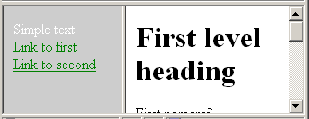

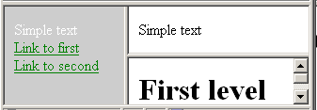
<FRAMESET COLS=“40%,*"> <FRAME SRC="body.html"> <FRAME SRC="second.html" NAME="Otrais"> </FRAMESET>
body.html …
<A HREF="First.html" TARGET="Otrais"> Link to first</A> <A HREF="Second.html" TARGET="Otrais"> Link to second</A>
…TARGET=“Bla-bla“…
Open in new window
<FRAMESET COLS="40%,*"> <FRAME SRC="body.html"> <FRAMESET ROWS="50%,*"> <FRAME SRC="first.html"> <FRAME SRC="second.html"> </FRAMESET> </FRAMESET>

Slide 7
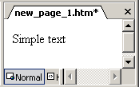
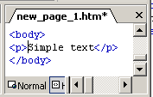
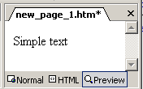
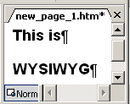
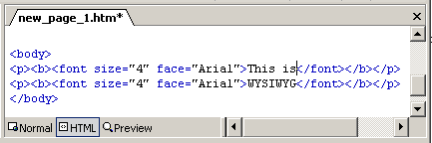
FrontPage 2000
<html>
<head>
<meta name="GENERATOR" content="Microsoft FrontPage> <meta name="ProgId" content="FrontPage.Editor.Document"> <meta http-equiv="Content-Type" content="text/html; charset=windows-1251"> <title>New Page 1</title> </head>
<body>
</body>
</html>
Teksts un rindkopas
Format / Font / 4 (14pt) / Arial / This is <Enter> WYSIWYG /

Slide 8
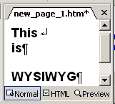
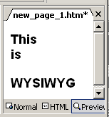
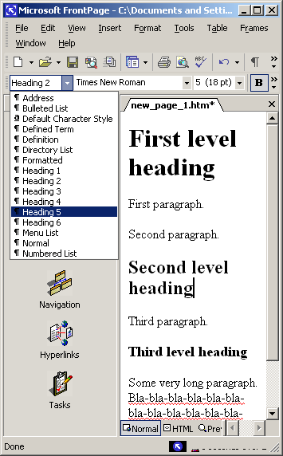
Insert / Break / Normal line break
…This <br>is…
Teksta formatēšana
<h1>First level heading</h1>
<h2>Second level heading</h2>
<h3>Third level heading </h3>
Format / Style …

Slide 9
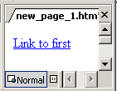
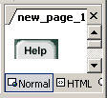

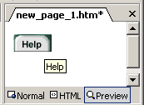
Hipersaite
Insert / Hyperlink / Text to display: Link to first / Look in: C:\first.html / OK
<a href="file:///C:/first.html">Link to first</a>
Attēlas ievietošana
Insert / Picture / From file / Look in: C:\tabhelp.gif / Insert
<img border="0" src="file:///C:/tabhelp.gif" width="46" height="21">
<Right click> / Picture properties / General / Alternative representations: Text: Help / OK
Attēla kā hipersaite
Picture properties / General / Default hyperlink: Location: C:\first.html/ OK
Picture properties / Appearance / Layout: Border thickness: …/ OK
Size: Width: Heigth:

Slide 10
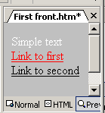
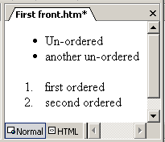
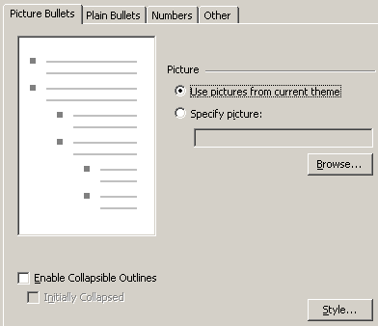
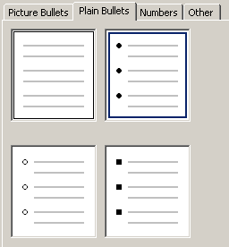
Lapu īpašības
<Right click> / Page properties / Background / Colors: Background: gray Hyperlink: green Text: white Visited hyperlink: red Active hyperlink: black / OK
Saraksti
<ul> <li>Un-ordered</li> <li>another un-ordered</li> </ul>
<ol> <li>first ordered</li> <li>second ordered</li> </ol>
<Right click> / List properties
Format / Style / ul / Modify / Format / Numbering

Slide 11
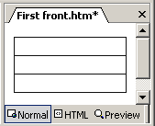
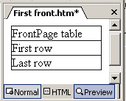
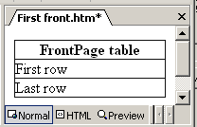
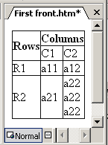
Tabulas
Table / Insert / Table / Size: Rows: 3 / Columns: 1 / Specify width: 100 / In percent / OK
<table border="1" cellpadding="0" cellspacing="0" width="100%"> <tr><td>FrontPage table</td></tr> <tr><td>First row</td></tr> <tr><td>Last row</td></tr> </table>
<Right click> / Cell properties / Layout: Header cell / OK
Horizontal alignment:
Vertical alignment:
Specify heigth:
Table / Insert / Table / Size: Rows: 4 / Columns: 3 / OK
<Select cells> / Table / Merge cells
<Select cells> / Table / Merge cells
<Fill-in cells> Columns / C1 / C2 / Rows / R1 / R2 / a11 / a12 / a21 / a22 a22 a22
<Right click on cell “Rows”> Cell properties / Layout: Header cell / OK
<Right click on cell “Columns”> Cell properties / Layout: Header cell / OK
<Select cells> / Table / Merge cells
<Select cells> / Table / Merge cells
<Fill-in cells> Columns / C1 / C2 / Rows / R1 / R2 / a11 / a12 / a21 / a22 a22 a22
<Right click on cell “Rows”> Cell properties / Layout: Header cell / OK
<Right click on cell “Columns”> Cell properties / Layout: Header cell / OK

Slide 12
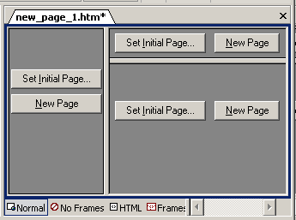
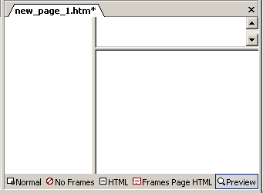
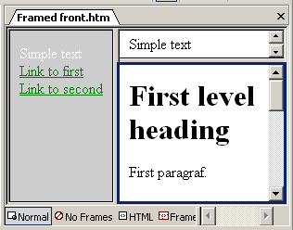
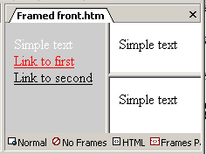

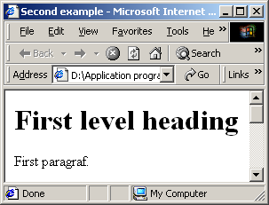
Freimi (Frames)
File / New / Page or Web / New from template / Page templates / Frames pages / Nested hierarchy
<Click> Look in: … body.html
<Click> Look in: … first.html
<Click> Look in: … second.html
<Right click> Frame properties / Name: rbottom
<Right click> Hyperlink properties / Target frame /
Click
Click

Slide 13
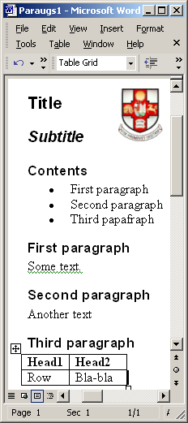
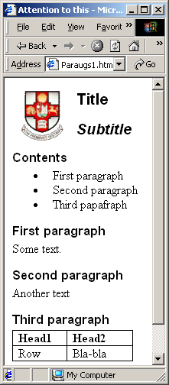
Word ⇨ Web
Word / File / Save As / Save as type: Web page / Change title / Attention to this / Save
Browser / File / Open / …
12(.htm)+6.56(.gif etc)=18.5KB
Word ⇨ Web (FrontPage)
FrontPage / Tools / Options / Configure Editors / Type: doc? / Add / File type: doc / Command: Browse frontpg.exe / Configure Editors / Open web pages in the Office application that created them: clear

Slide 14
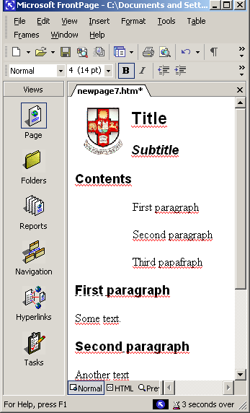
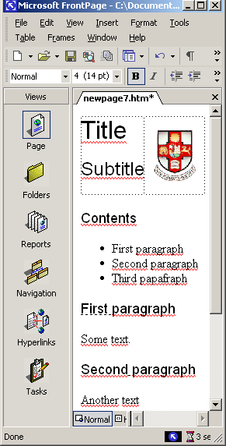
  FrontPage / File / Open / Files of type: Word 97-2000 …
Table / Insert / Table / Rows: 1 / Columns: 2 / Border size: 0 / Specify Width: 100 In percent
Heading1
Heading2
Heading3
Bulleted List
    File / Save as / Save as type: Web page / Save / Embedded files to save: … Rename …Change folder … Picture options …
1.7(.htm)+4.7(.gif)=6.4KB vs 12(.htm)+6.56(.gif)=18.5KB

Slide 15
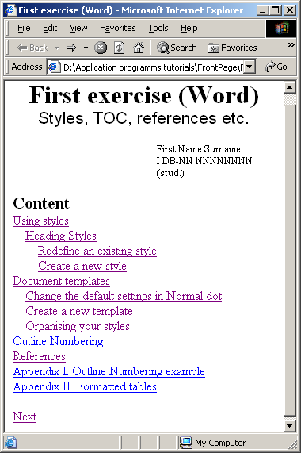
Bookmarks
File
File

Slide 16
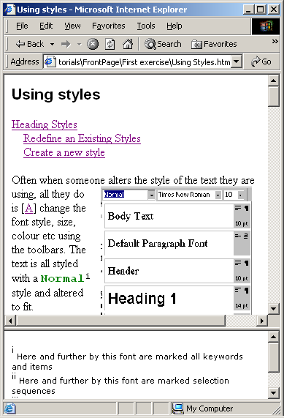

Slide 17
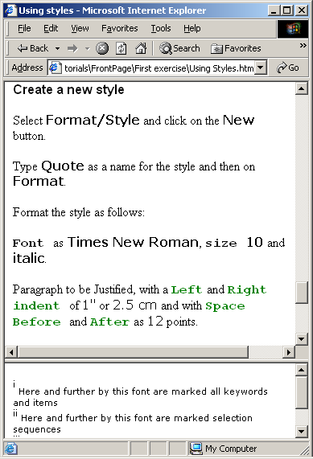
Selection
Item

Slide 18
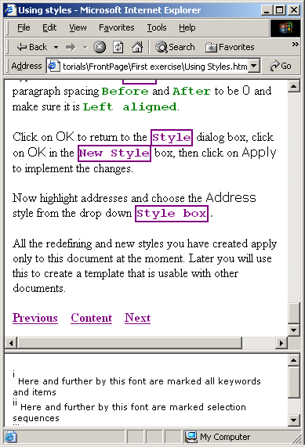
Box

Slide 19
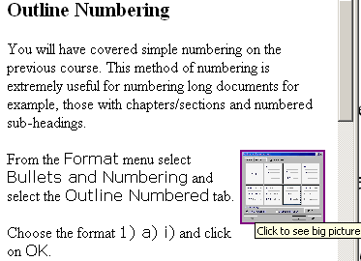
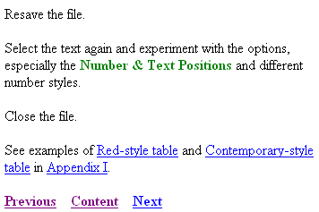

Slide 20
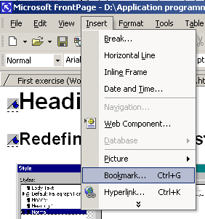
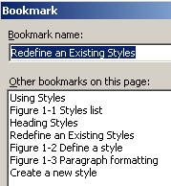
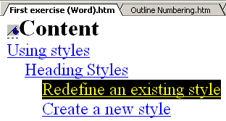




Slide 21



Slide 22






Styles (Cascading Style Sheet – CSS)
File / New / Page or Web / New from template / Page templates / Style Sheets / Normal Style Sheet
Format / Style / New / Name: Item / Style type: Character / Format / Font …
Save As / File name: Style Sheet / OK
Format / Style Sheet Links/ Add /
Internal styles
External styles (CSS)

